Slide 1
VBT Gen Tool Template Generator User Manual

Slide 2
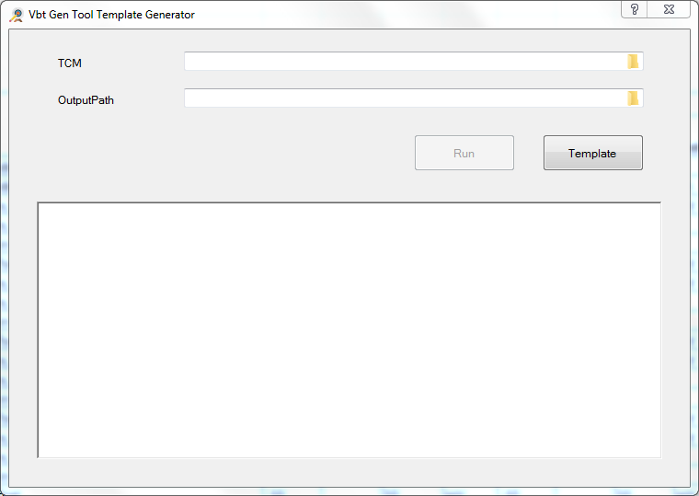
VBT Gen Tool Template Generator
Purpose
To generate VBT Gen Tool Template by TCM
GUI

Slide 3
VBT Gen Tool Template Generator
TCM Format
Test Plan Name : This is function name in VBT_Gen_Tool.
ATE datalog Name : This is datalog name with COMMAND: DATALOG.
ATE Limits/Low : Low Limit in VBT_Gen_Tool.
ATE Limits/Upper : High Limit in VBT_Gen_Tool.
ATE Limits/Unit : Unit in VBT_Gen_Tool.
Trim Test? : If “Yes”, generate [SheetName]_test. If “No”, generate [SheetName]_Post. Others generate [SheetName] only.
Output

